Slide 1
AMERICAN INTERNATIONAL UNIVERSITY – BANGLADESH (AIUB)
Faculty of Science and technology
Course: Software Engineering
Course Teacher: Dr.Razib Hayat Khan
Assistant Professor,CS
GROUP MEMBERS
FATIN ISHRAK RAHMAN,19-39862-1
JEBA FAWJIA,19-39815-1
FATHEMA AKTER MOONMOON,19-40161-1
FAHAD BIN AHMED,19-41719-3

Slide 2
Project Name
Donation Management System

Slide 3


Requirement Gathering
Based on social helping and emergency response.
Created for searching purpose and to decrease people’s need.
Best option for those people who interested for donating and assistance.

Slide 4

Basic Functionality
Donation Category:
Blood
Organ
Money

Slide 5
OBJECTIVES
Ensure quick response on any emergency
Create social response, build financial and humanitarian capability.

Slide 6
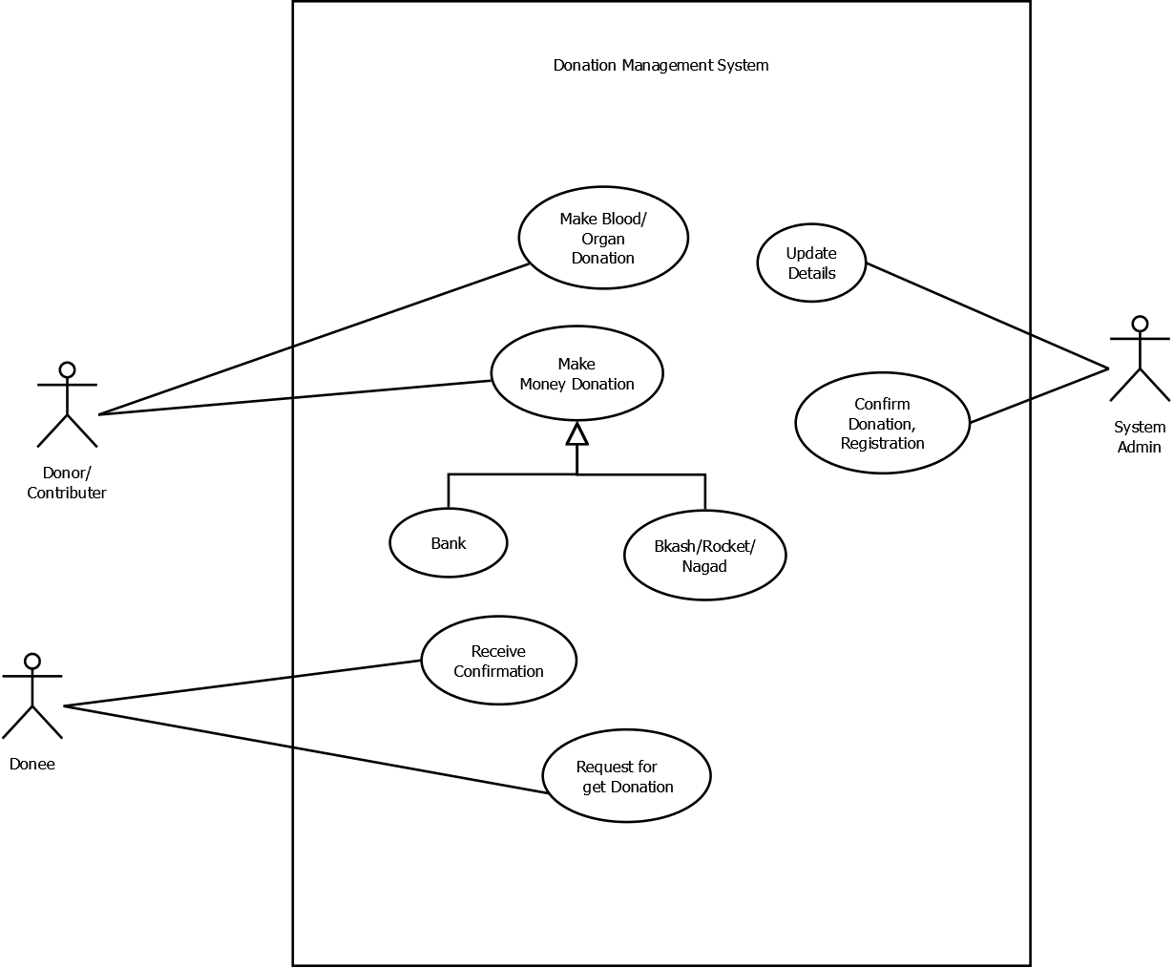
Use Case Diagram
Donor,Donee and System Admin represented as an Actor

Slide 7
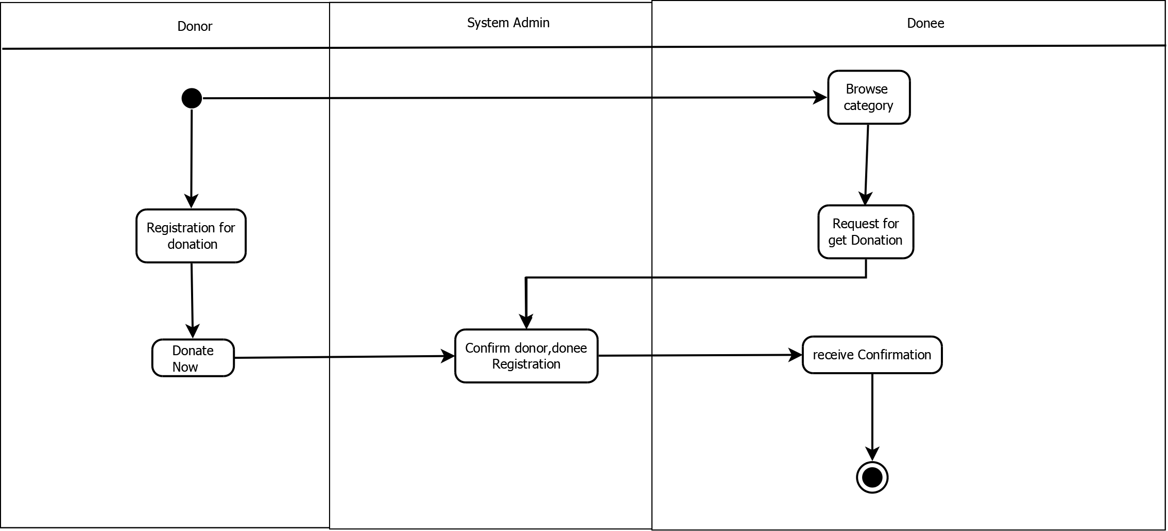
Activity Diagram
Graphical representation of workflows of activities

Slide 8
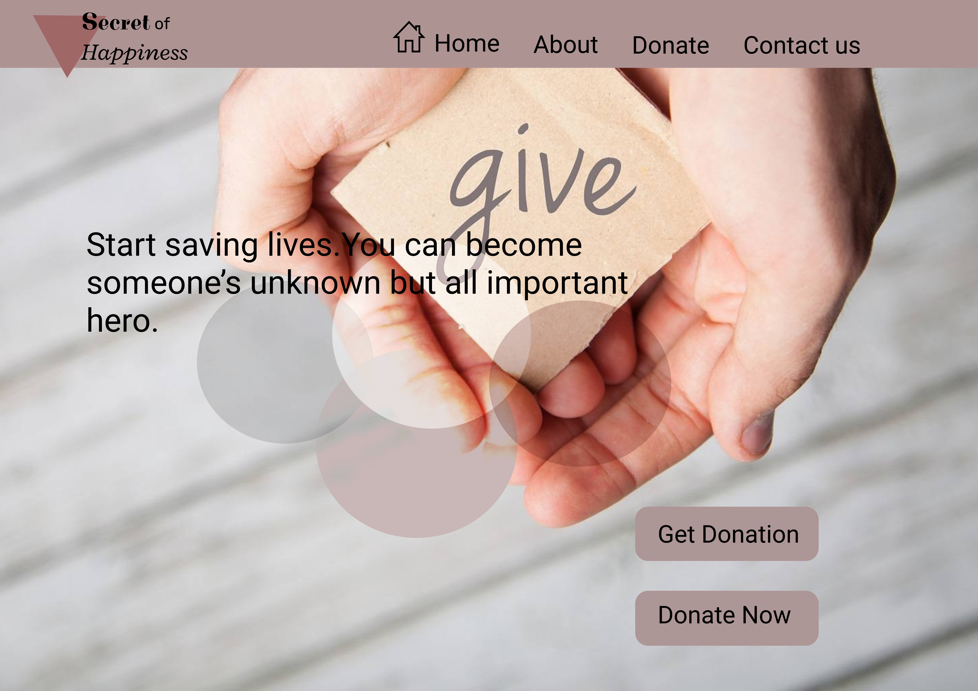
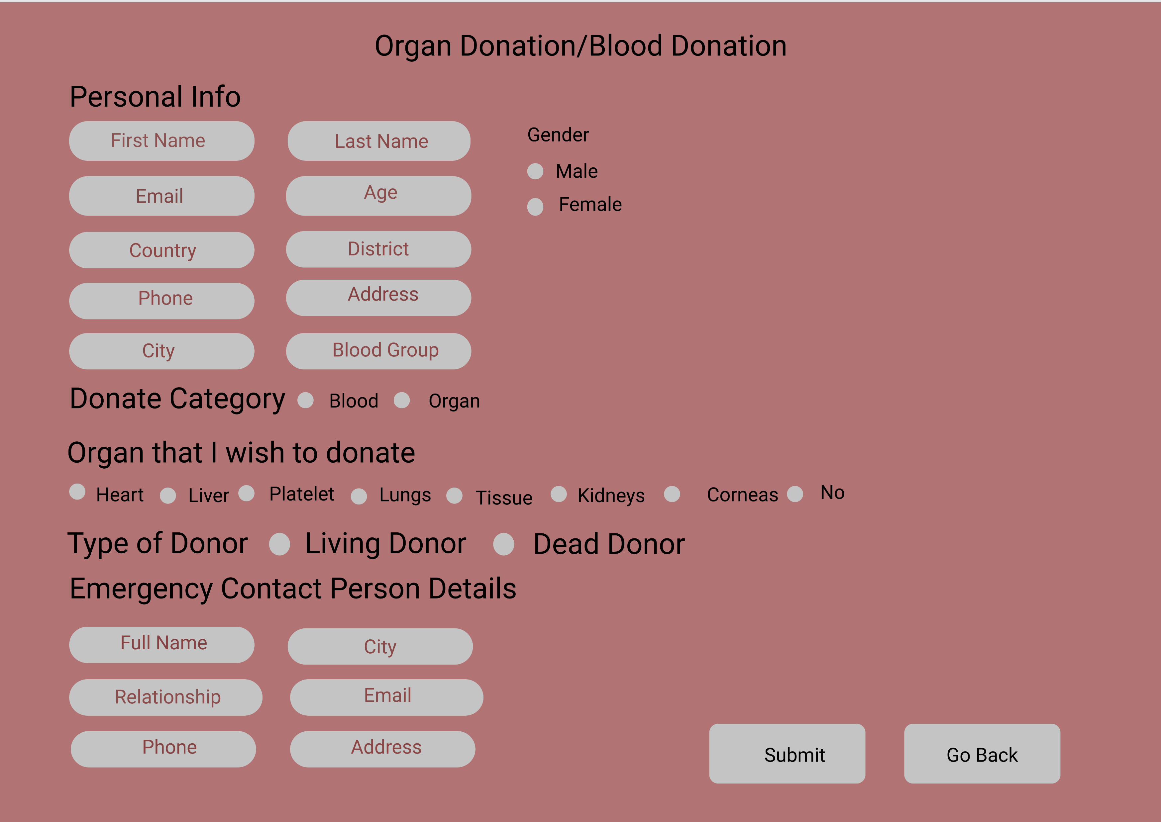
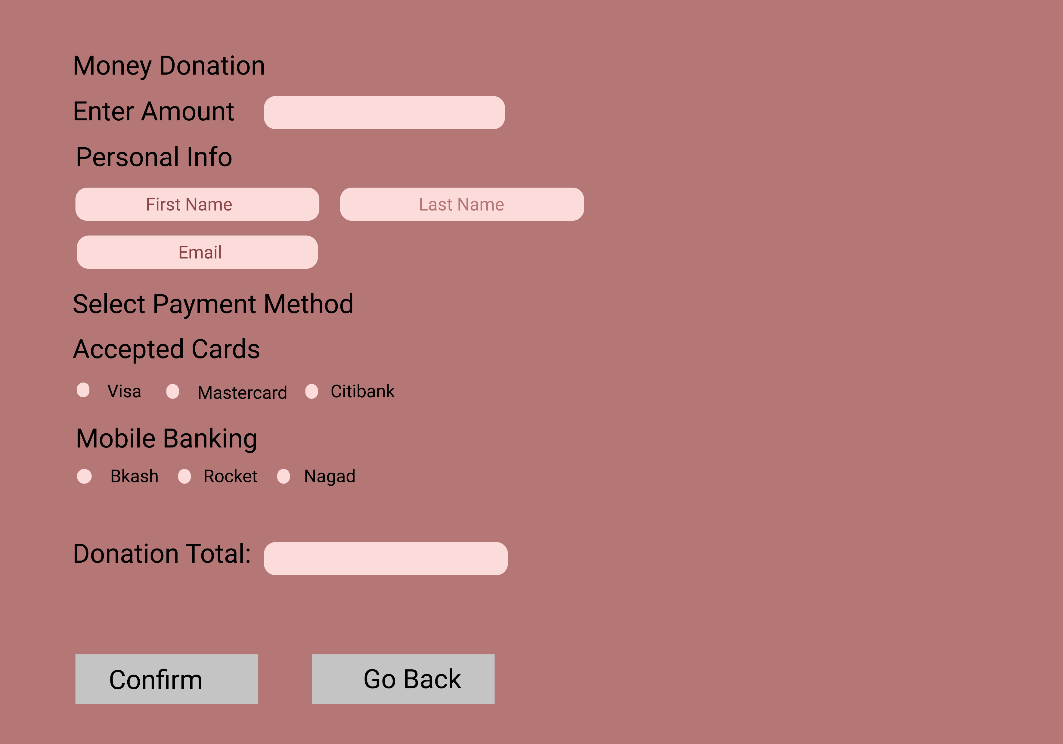
User Interface

Slide 9
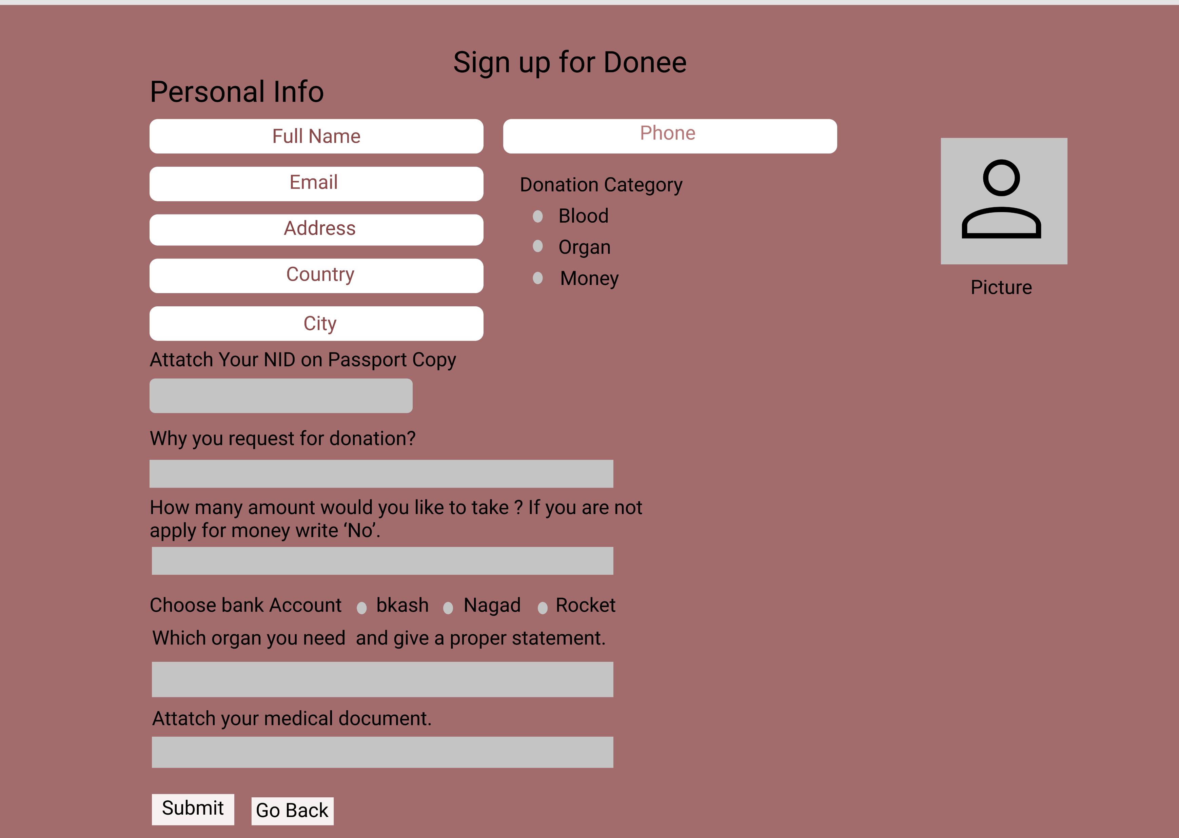
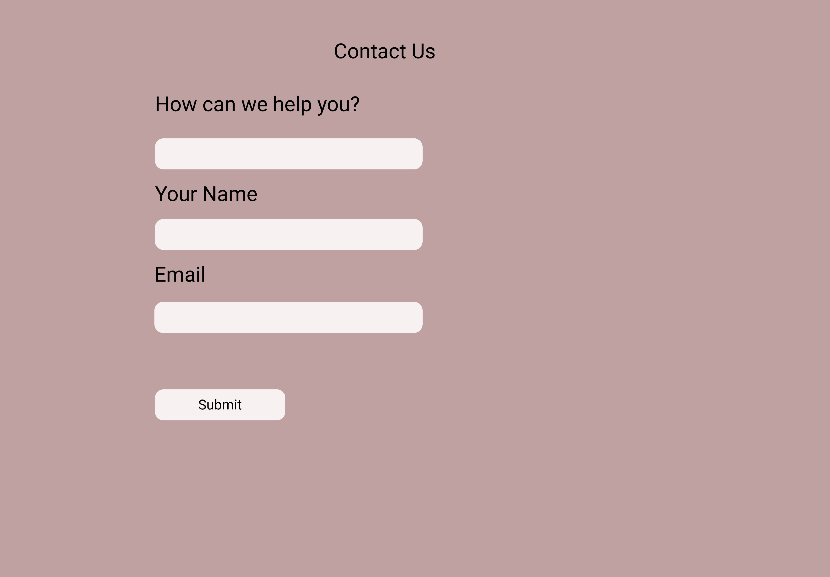
User Interface

Slide 10
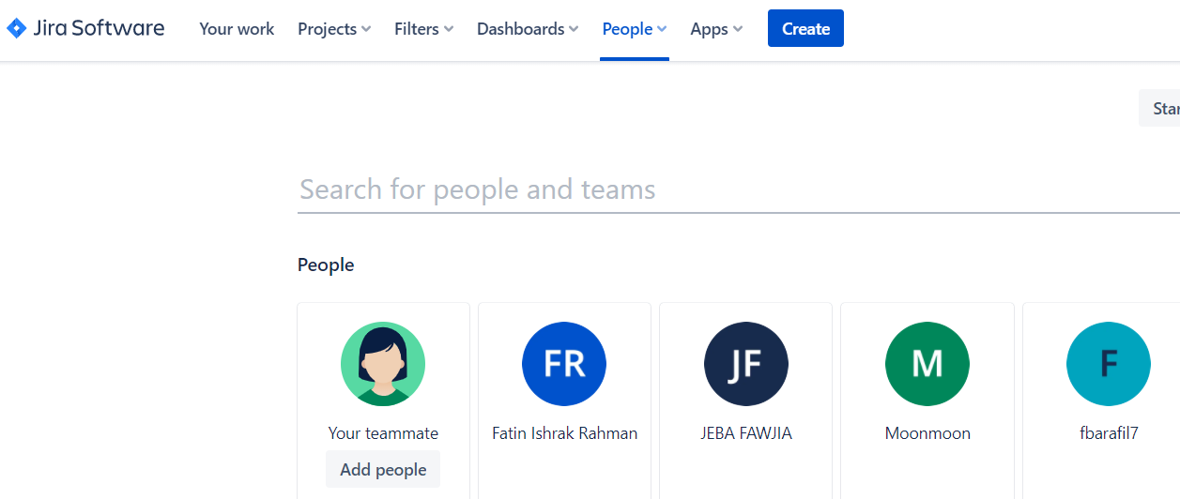
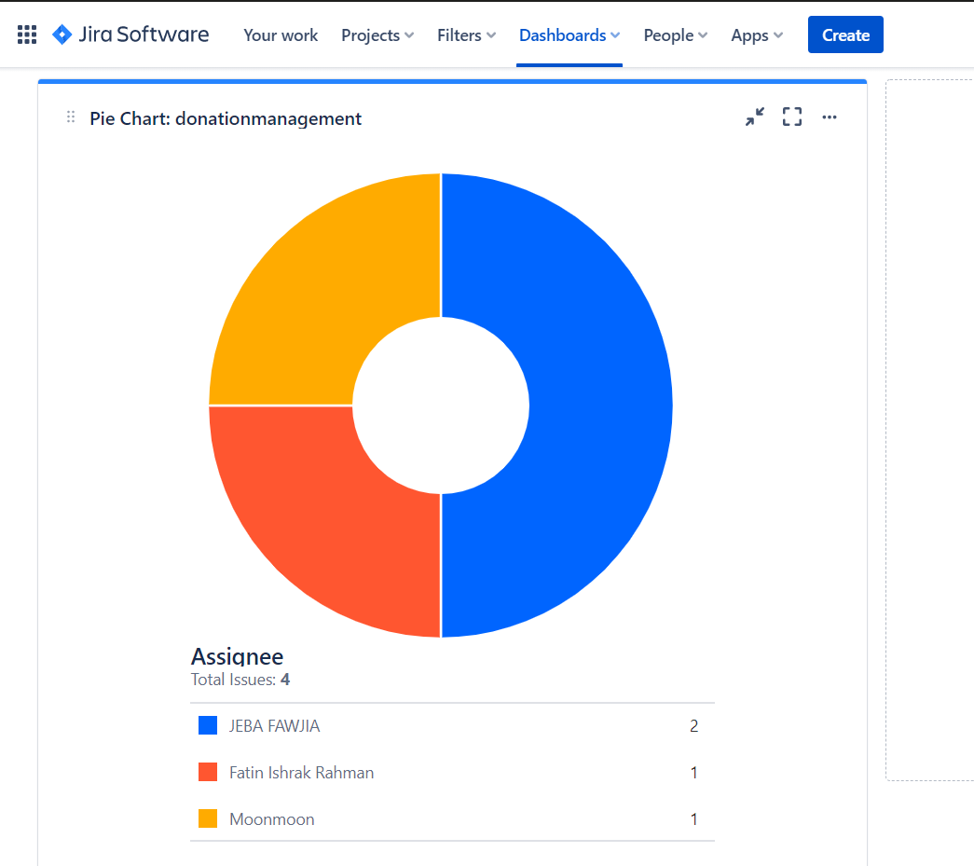
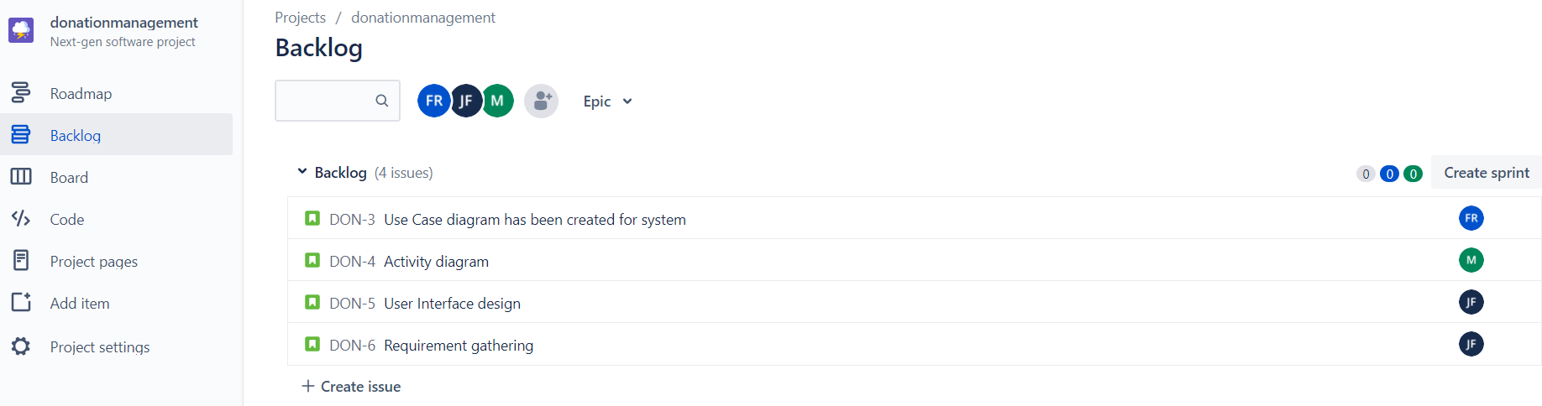
Jira

Slide 11
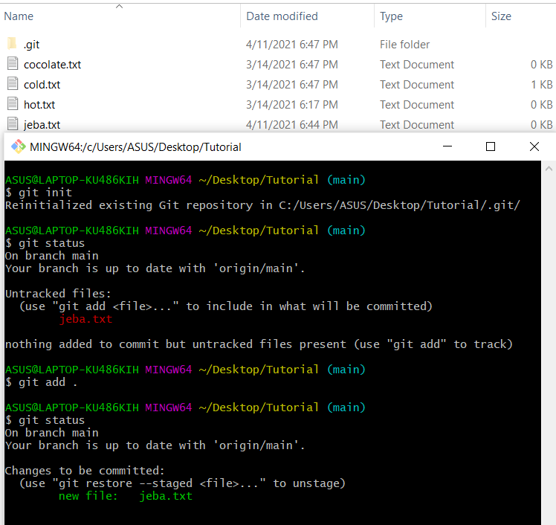
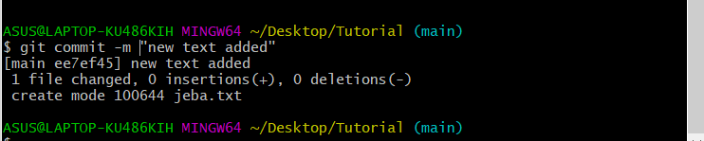
Git

Slide 12
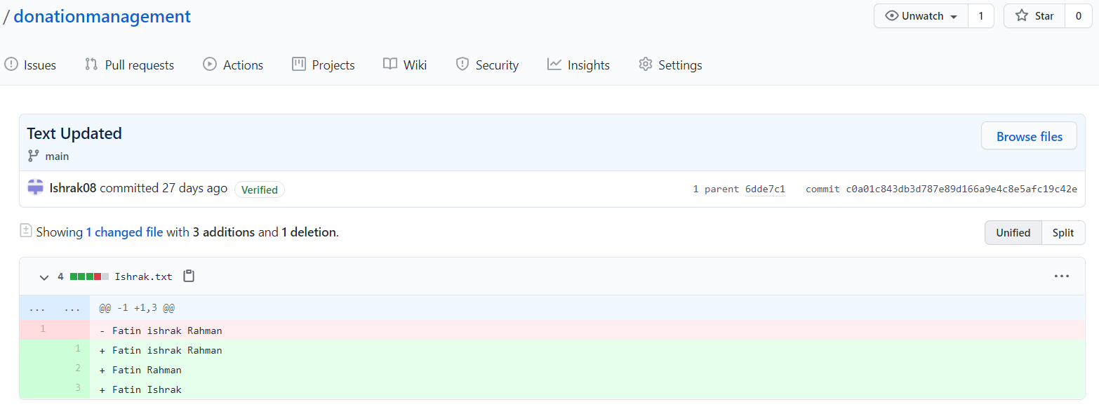
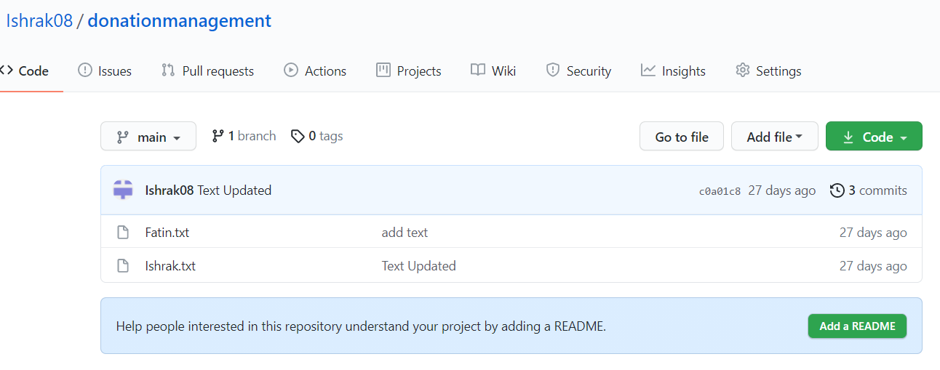
GitHub

Slide 13
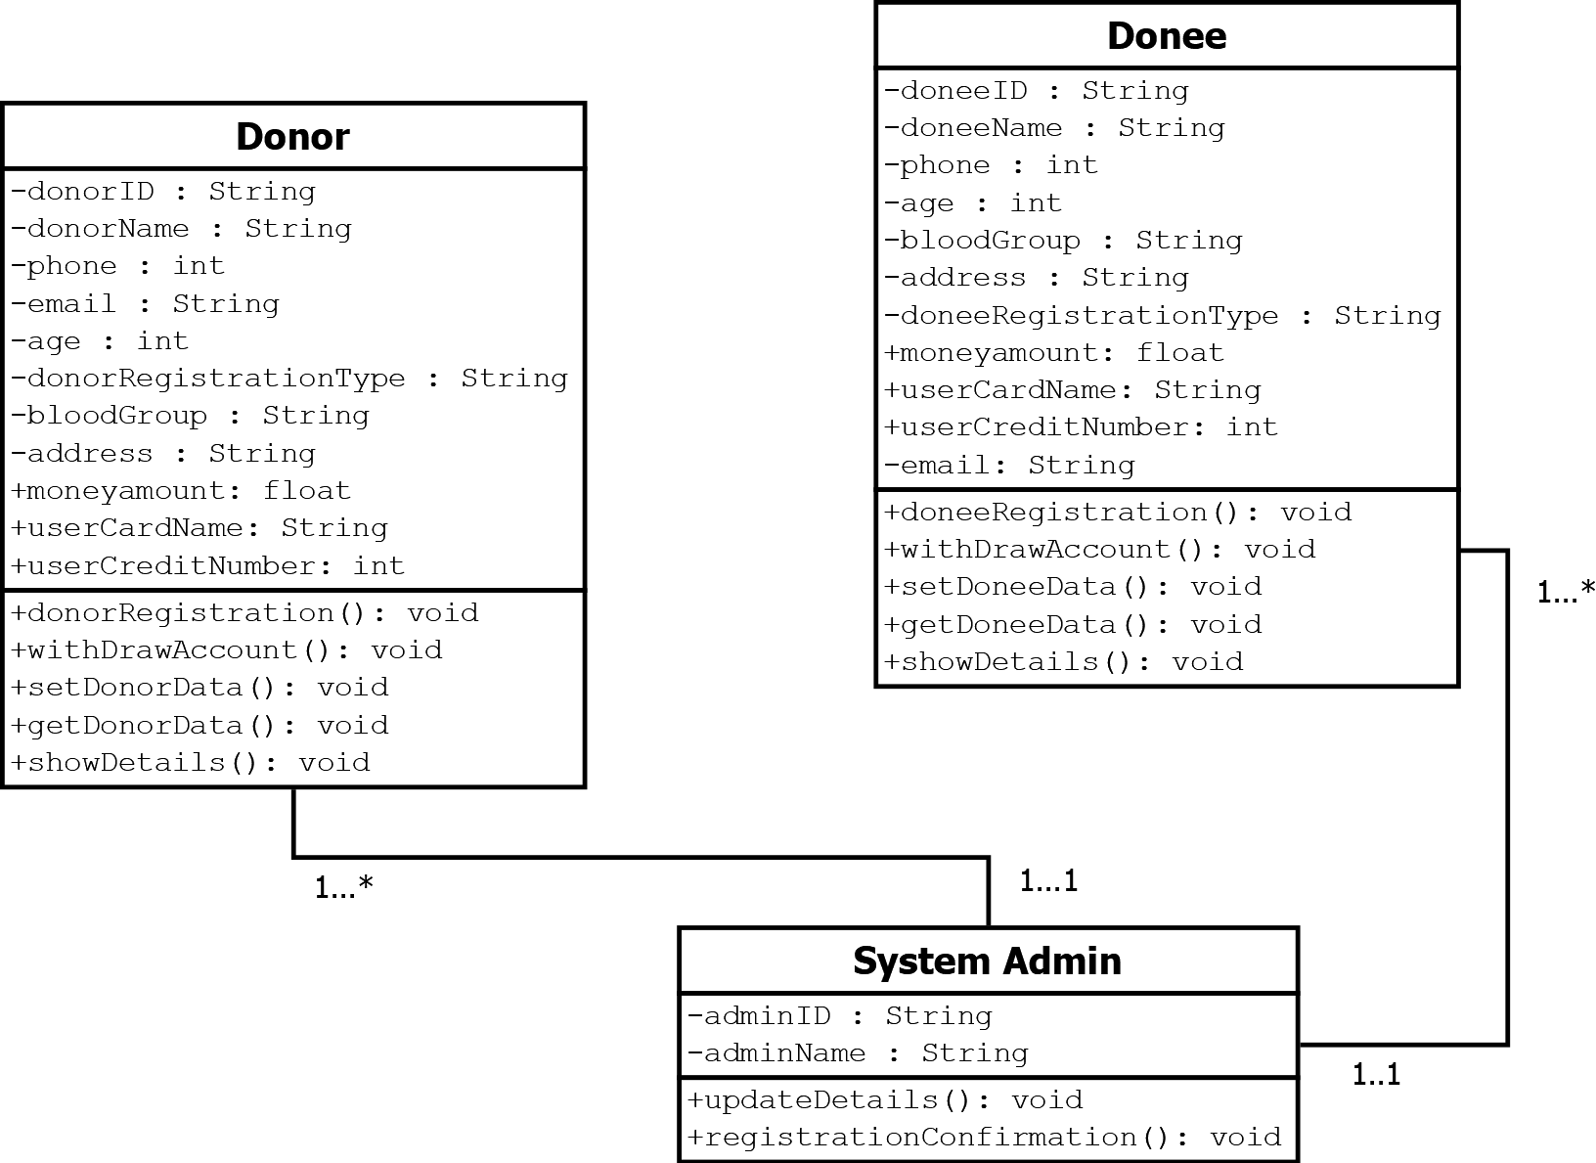
Class Diagram
Donor,Donee,System Admin represented as an Atribute

Slide 14
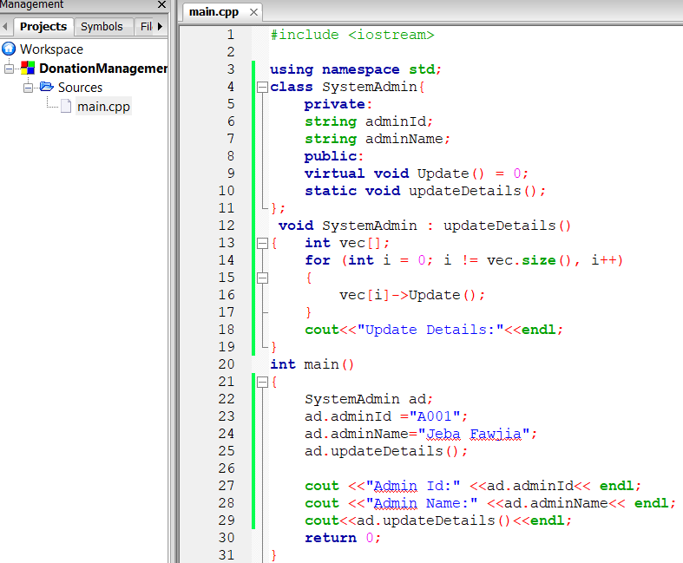
Code

Slide 15
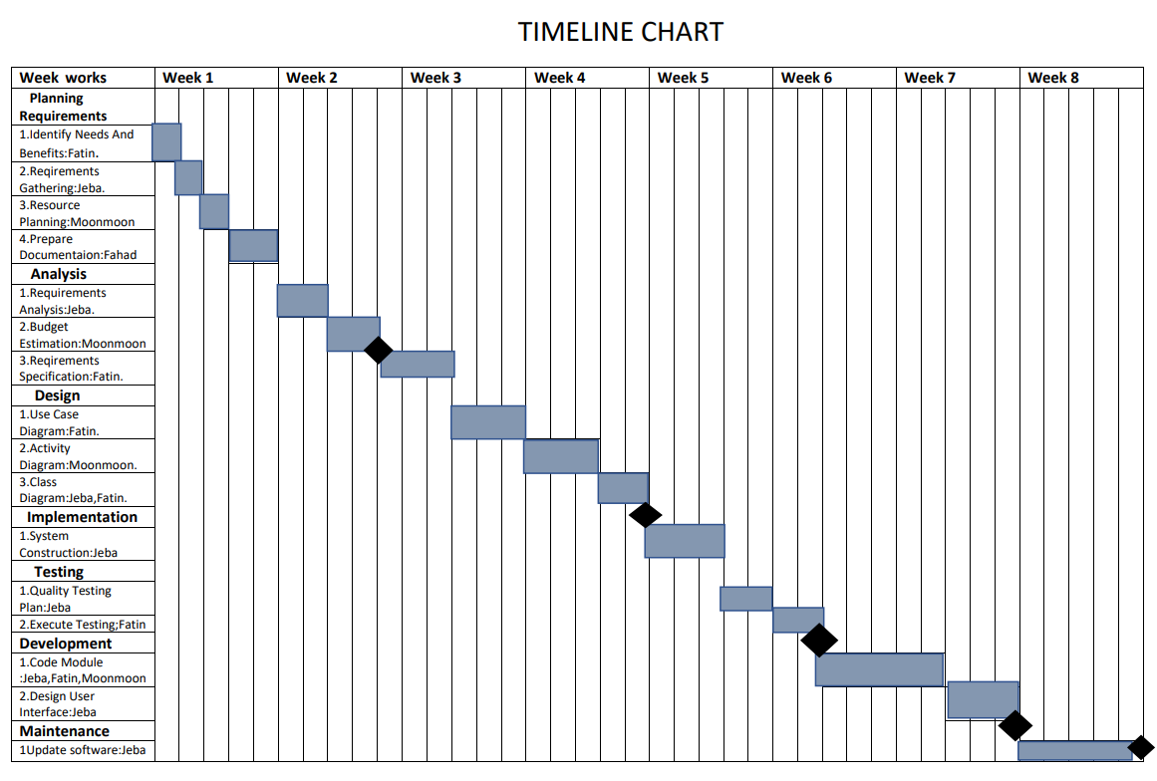
Project Scheduling

Slide 16
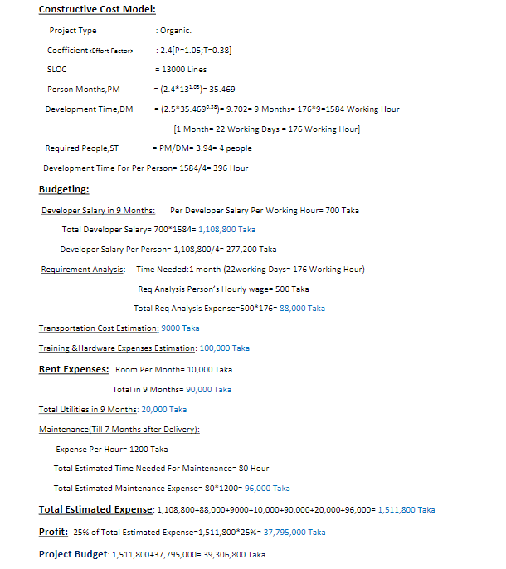
Effort Estimation and Budgeting

Slide 17


